Slide 1



BRIDGES
Hashiwokakero Game Using Greedy Algorithms
Graph Puzzle Game
Team - 4
Team Members
D.Kishore Reddy (CB.SC.U4CSE24010)
Santhosh.V (CB.SC.U4CSE24047)
Hasini (CB.SC.U4CSE24068)
Tulasi Sadhwika (CB.SC.U4CSE24054)
01

Slide 2
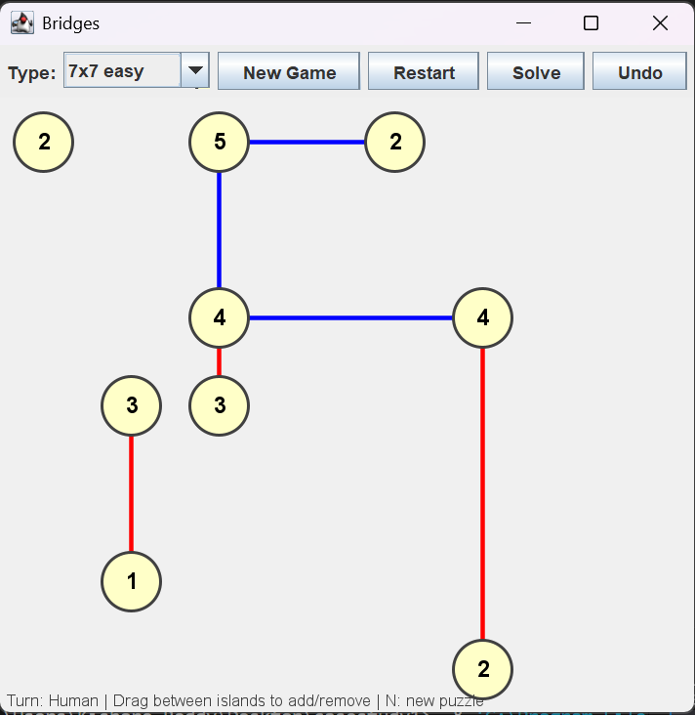
BRIDGES
ABOUT GAME
What is Hashiwokakero?
A logic-based bridge-connecting puzzle
Islands are placed on a grid
Each island has a number showing required bridges
Goal of the Puzzle
Connect all islands using bridges
Follow strict placement rules
Form one single connected structure
02

Slide 3
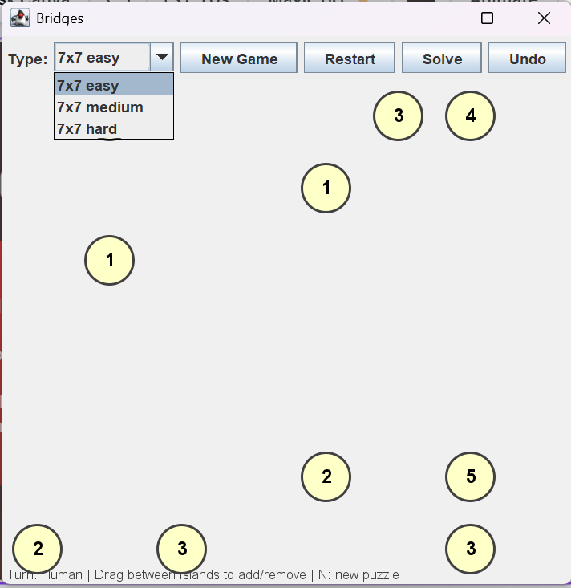
BRIDGES
ABOUT GAME RULES
Bridges can be only horizontal or vertical
Bridges cannot cross each other
Maximum two bridges between any two islands
Each island must satisfy its exact degree
All Islands in the puzzle must be connected
03

Slide 4
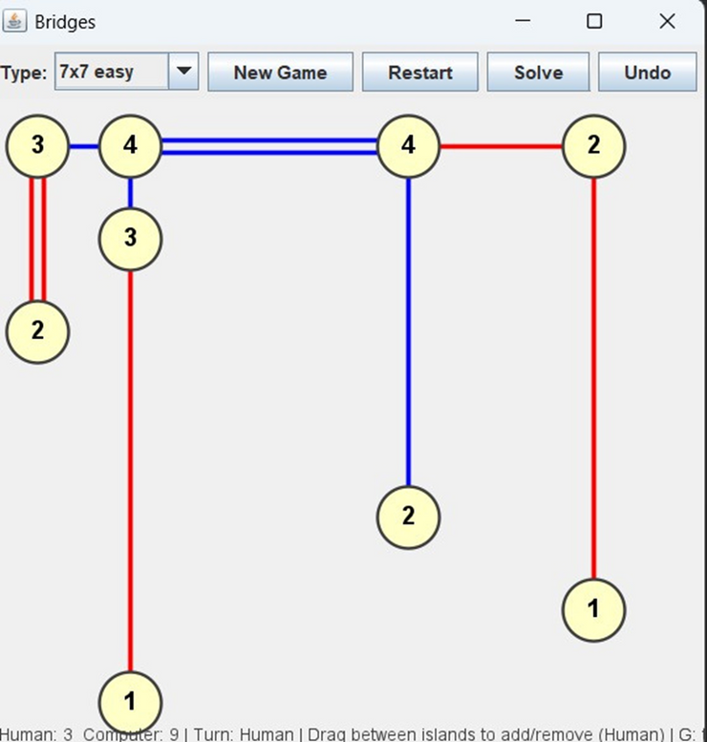
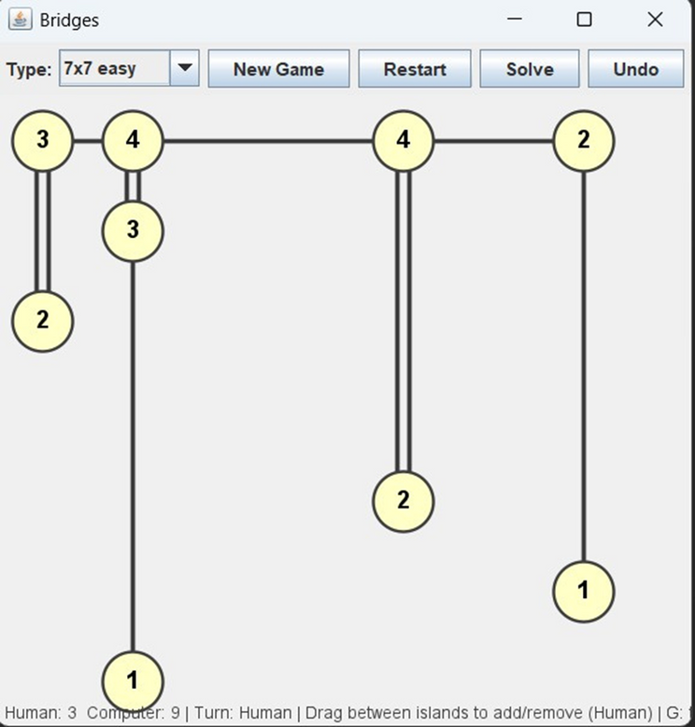
BRIDGES
RULE ENFORCEMENT
An island still needs bridges but, All possible neighbors are blocked Or connecting would
exceed degree constraints
Human Completes local islands greedily Blocks future necessary connections Effect AI cannot fix huan mistakes BFS later finds disconnected components or deadlocks
08

Slide 5

BRIDGES
objective
“To develop a solvable Hashiwokakero game that applies graph-based modeling and greedy algorithms to implement an intelligent CPU opponent.”
01
02
03
04
Build a fully playable Hashiwokakero game
Interactive mouse-based gameplay
Ensure puzzles are always solvable
This becomes the visible puzzle.
Implement an intelligent CPU opponent
So we design it as a rule-based + greedy algo.
Apply greedy algorithms meaningfully
At each step, choose the move that reduces future uncertainty the most, without violating constraints.
04

Slide 6
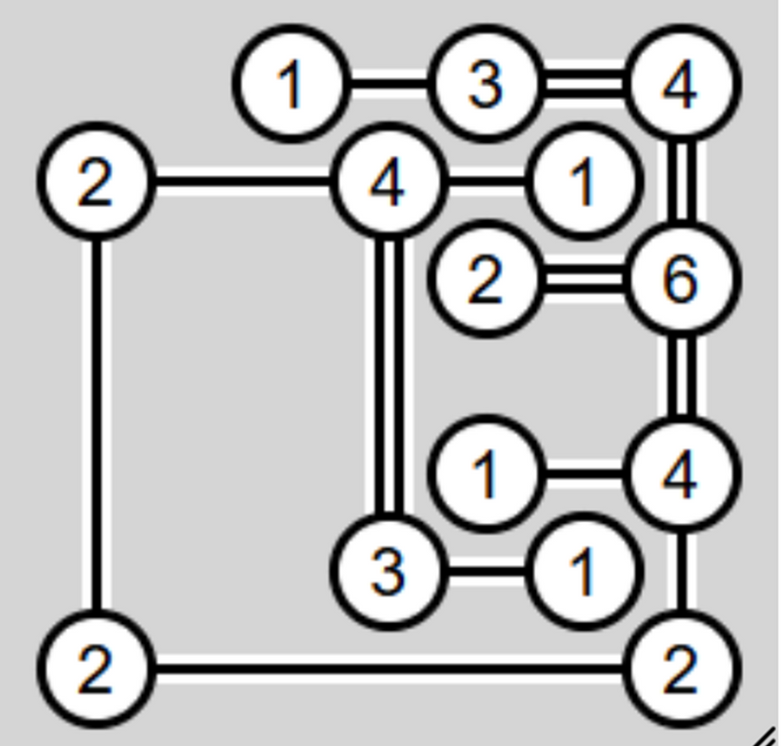
BRIDGES
GAME DESIGN OVERVIEW
Human vs CPU turn-based gameplay
Mouse-drag interaction for bridges
Color-based visual feedback
Undo, restart, and solve options.
01
Design Focus Strict rule enforcement
at every step of the game for a Smooth experience.
02
05

Slide 7
BRIDGES
GRAPH REPRESENTATION OF THE GAME
Graph Modeling
Islands → Vertices (Nodes)
Bridges → Undirected Edges
01
GRAPH ALGORITHM FUNCTIONS
buildAdjacencyList() isConnected() computeComponents()
Why Graph Representation?
Degree constraint → vertex degree
Connectivity → graph traversal
Valid solution → connected graph with exact degrees
BridgesAdvanced()
02
06

Slide 8
BRIDGES
CORE DATA STRUCTURES
Main Classes in Code
Island → represents a graph vertex
Bridge → represents a graph edge
Move → represents a CPU candidate action
Function
mousePressed(MouseEvent e)
mouseReleased(MouseEvent e)
mouseDragged(MouseEvent e)
mouseClicked(MouseEvent e)
mouseEntered(MouseEvent e)
mouseExited(MouseEvent e)
07
mouseMoved(MouseEvent e)

Slide 9
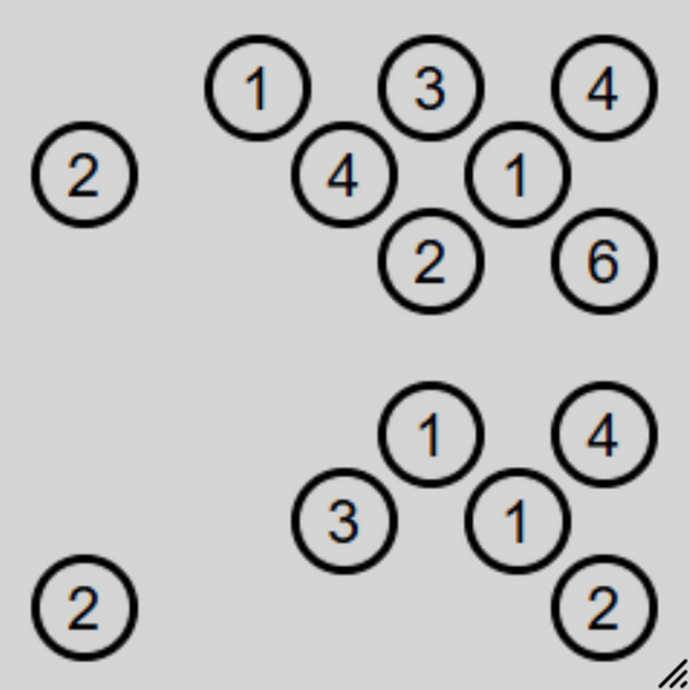
BRIDGES
FUNCTION
generatePuzzle()
showSolution()
restartPuzzle()
PUZZLE GENERATION LOGIC
01
Random island placement
02
Build spanning structure for connectivity
03
Add extra bridges for complexity
04
Compute required degrees
09

Slide 10
BRIDGES
GREEDY CPU OVERVIEW
CPU Characteristics
FUNCTIONS
Why Greedy?
Fully deterministic
Rule-compliant
No randomness
No backtracking
makeAIMove()
addBridgeForAI()
getBridgeCount(Island i)
computeComponents()
canConnect()
Constraints are irreversible
Early wrong moves cause dead ends
Greedy makes safe local decisions
10

Slide 11
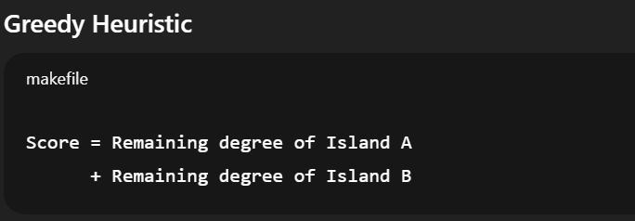
BRIDGES
GREEDY HEURISTIC & BORŮVKA
Borůvka Principle
Prefer edges connecting different components
Improves global connectivity early
11

Slide 12
BRIDGES
GRAPH ALGORITHMS
Function
Breadth-First Search (BFS)
Connected Component Detection
“The puzzle is modeled as a graph where BFS ensures connectivity and identifies components for rule checking and CPU strategy.”
isConnected()
computeComponents()
buildAdjacencyList()
getBridgeCount(Island i)
Purpose
Check connectivity
Guide CPU decision-making

Slide 13
BRIDGES
BFS CONNECTIVITY CHECK
Islands are modeled as graph vertices
Bridges act as undirected edges
BFS traversal visits all reachable islands
Puzzle is valid only if all islands are connected
Start BFS from any island
Visit all reachable islands
Compare visited count with total islands
BFS guarantees that the Hashiwokakero puzzle forms a single connected graph.”
Functions
buildAdjacencyList()
isConnected()
isSolved()

Slide 14
BRIDGES
Methods Used
SOLUTION VERIFICATION CONDITIONS
isConnected()
getBridgeCount()
Puzzle is Solved If:
Graph is fully connected
Every island’s degree equals its required value
“Solution verification ensures all islands are connected and each island’s bridge count matches its number.”

Slide 15
BRIDGES
PROOF OF CORRECTNESS
“isSolved() ensures the puzzle is solved only if all islands are connected and each island’s bridge count matches its required number.”
f isSolved() returns true, then the puzzle is solved correctly
Assume (Contradiction)
isSolved() returns true but the puzzle is incorrect.
For isSolved() to return true:
isConnected() == true
Functions
AND
getBridgeCount(isl) == isl.required for all islands
canConnect(Island a, Island b, List<Bridge> extra)
.
islandBetween(Island a, Island b, Island c)
Contradiction:
.
If graph is connected → no isolated islands
bridgesCross(Island a1, Island b1, Island a2, Island b2)
findBridge(Island a, Island b, List<Bridge> list)
If all degrees match → no under/over-connected islands
findBridge(Island a, Island b)
getBridgeCount(Island isl)
Both violate the assumption that the puzzle is incorrect.
Contradiction reached.
✔ isSolved() is correct.

Slide 16
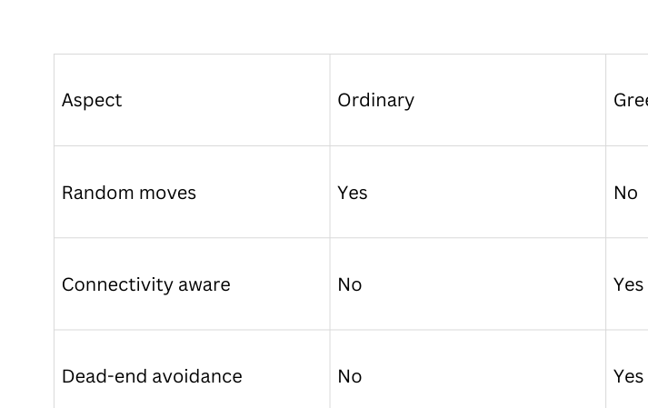
BRIDGES
GREEDY vs ORDINARY APPROACH
[12:43 am, 26/12/2025] Kishore Reddy: GOOD NIGHT BRO[1:45 pm, 26/12/2025] Santosh Amrita: Always selects a legal movePrefers moves that reduce constraints firstConnects disconnected components only
Always selects a legal move
Always selects a legal move
Prefers moves that reduce constraints
firstConnects disconnected components only.

Slide 17
BRIDGES
GAME SIMULATION FLOW
Turn Execution
Human Move → Rule Validation → Greedy CPU Move → Connectivity Check → Repeat
Human Move
Validation
↓ ↓
↓ ↓
CPU Greedy Move
Observations CPU connects components first
CPU resolves tight constraints early
↓ ↓
Check Solved
↓ ↓
Next Turn

Slide 18
BRIDGES
CONCLUSION
Final Outcome
Graph theory applied effectively
Greedy CPU ensures correctness and efficiency
Intelligent CPU gameplay achieved
“Thus, greedy is the most suitable strategy for this problem.”

Slide 19

CONTRIBUTIONS:
Individual Contribution Information
Tulasi Sadhwika - CB.SC.U4CSE24054
B.Hasini - CB.SC.U4CSE24068
• Designed and implemented AI logic
• Applied Borůvka’s principle and heuristic sorting
• Optimized greedy decision-making strategy
. Designed overall game architecture
• Implemented puzzle generation logic
• Managed Java Swing UI components
Santhosh.V - CB.SC.U4CSE24047
Devara Kishore Reddy – CB.SC.U4CSE24010
• Implemented input handling and rendering logic
• Managed mouse interactions and animations
• Prepared documentation and presentation material
. Implemented graph algorithms (BFS, connected components)
• Developed solution verification logic
• Assisted in debugging and testing

Slide 20
BRIDGES
THANK YOU

